Slide 1
Hospital Network System
Presented by-
Name : Jannatul Firdous Samiya
ID : 222400024
Course Code : CSE-416
Course Title : Computer Network Lab
Department Of CSE

Slide 2

Objective
Build a fully functional hospital network using Cisco Packet Tracer
Enable communication between different hospital departments
Ensure real-time connectivity across PCs and routers
Provide internet simulation (DNS, HTTP, FTP, etc.)

Slide 3
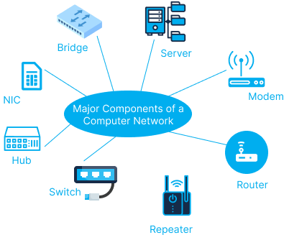
Network Components Used
Routers: 6
Switches: 6 (2960-24TT Switches)
End Devices: PCs, Servers, Wireless Devices
Servers: DNS, HTTP, FTP, SMTP, DHCP
Others: Wireless Router, Smartphones, Tablets

Slide 4
Hospital Segments
1st Floor-
Entrance Reception
Lobby/Guest Wi-Fi
2nd Floor-
Clinical Area
General Ward
Private Ward
3rd Floor-
IT Department

Slide 5
Connectivity Overview
Routing: Static/Manual Routing
Servers:
DNS + HTTP: 192.168.1.10
FTP + SMTP: 192.168.1.11
Guest Wi-Fi Zone: Wireless Router → Tablets, Smartphones

Slide 6
Security Features Used
Security Features Implemented-
1. Network Segmentation Using Subnetting: Each department is assigned a unique IP subnet (e.g., 192.168.1.0, 192.168.2.0, etc.).This provides basic logical separation between hospital units.
2. Static IP Addressing: Manual IP configuration helps maintain fixed device identification.Ensures predictable routing and avoids random IP conflicts.
3. Isolated Guest Wi-Fi Network: The Guest Wi-Fi zone is separated from internal hospital systems. Internet-only access ensures guests cannot reach internal servers or PCs.

Slide 7
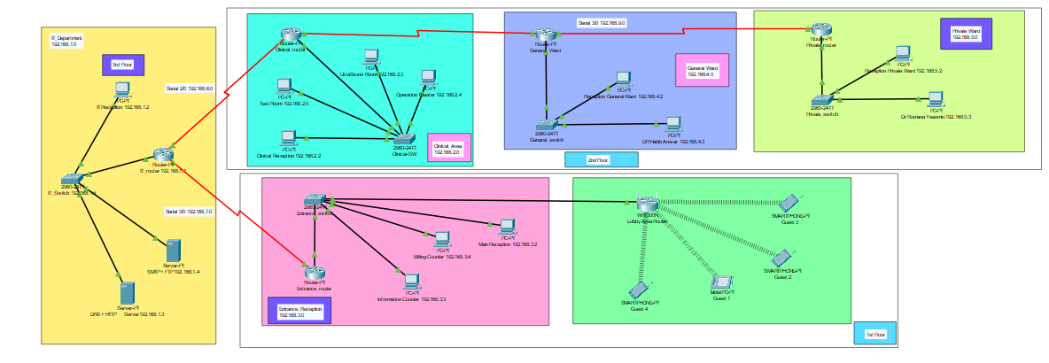
Network Diagram

Slide 8
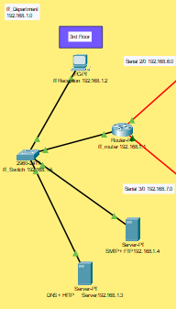
IT Department
Network: 192.168.1.0
Hosts essential servers: DNS, HTTP, FTP, SMTP
Central hub for routing and connectivity
Supports communication across all other departments

Slide 9
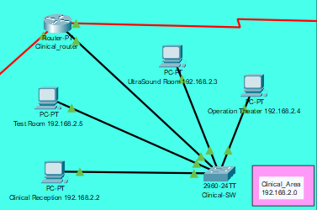
Clinical Area
Network: 192.168.2.0
Includes: Clinical Reception, Test Room, Ultrasound, Operation Theater
Main area for patient diagnosis and treatment
Connected with General Ward, Private Ward, and IT

Slide 10
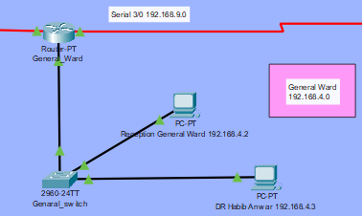
General ward
Network: 192.168.4.0
Consists of: Reception, General Ward PCs, Dr. Habib’s PC
Manages patients admitted in shared spaces
Exchanges data with Clinical and Private Ward

Slide 11
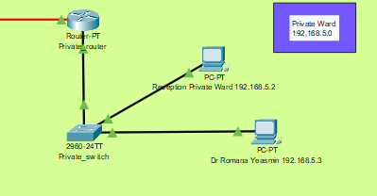
Private ward
Network: 192.168.5.0
Contains: Private Reception, Nurse PC, and Private Rooms
Handles high-priority or private patient cases
Communicates with Clinical and General Wards

Slide 12
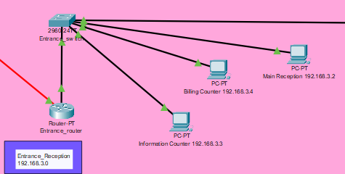
Entrance Reception
Network: 192.168.3.0
Includes: Main Reception, Information Counter, Billing Counter
First point of contact for patients and visitors
Connects to all internal hospital departments

Slide 13
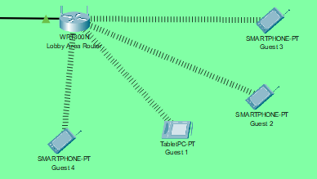
Lobby / Guest Wi-Fi
Network: 192.168.6.0
Connected via a Wireless Router
Provides internet access to guests (Tablets, Smartphones, Laptops)
Isolated from internal hospital systems for security

Slide 14
Conclusion
Successfully built and simulated a hospital network
All departments are interconnected
Functional servers and guest WiFi included
Future scope: Add VLANs, security (ACLs), load balancing

